Slide 1
FINAL INTERNSHIP PRESENTATION
]
Presented by Fariha Moazzema Raisa

Slide 2
DEVELOPING THE FRONT END OF A WEBSITE SIMILAR TO THAT OF TECHNUF
]

Slide 3
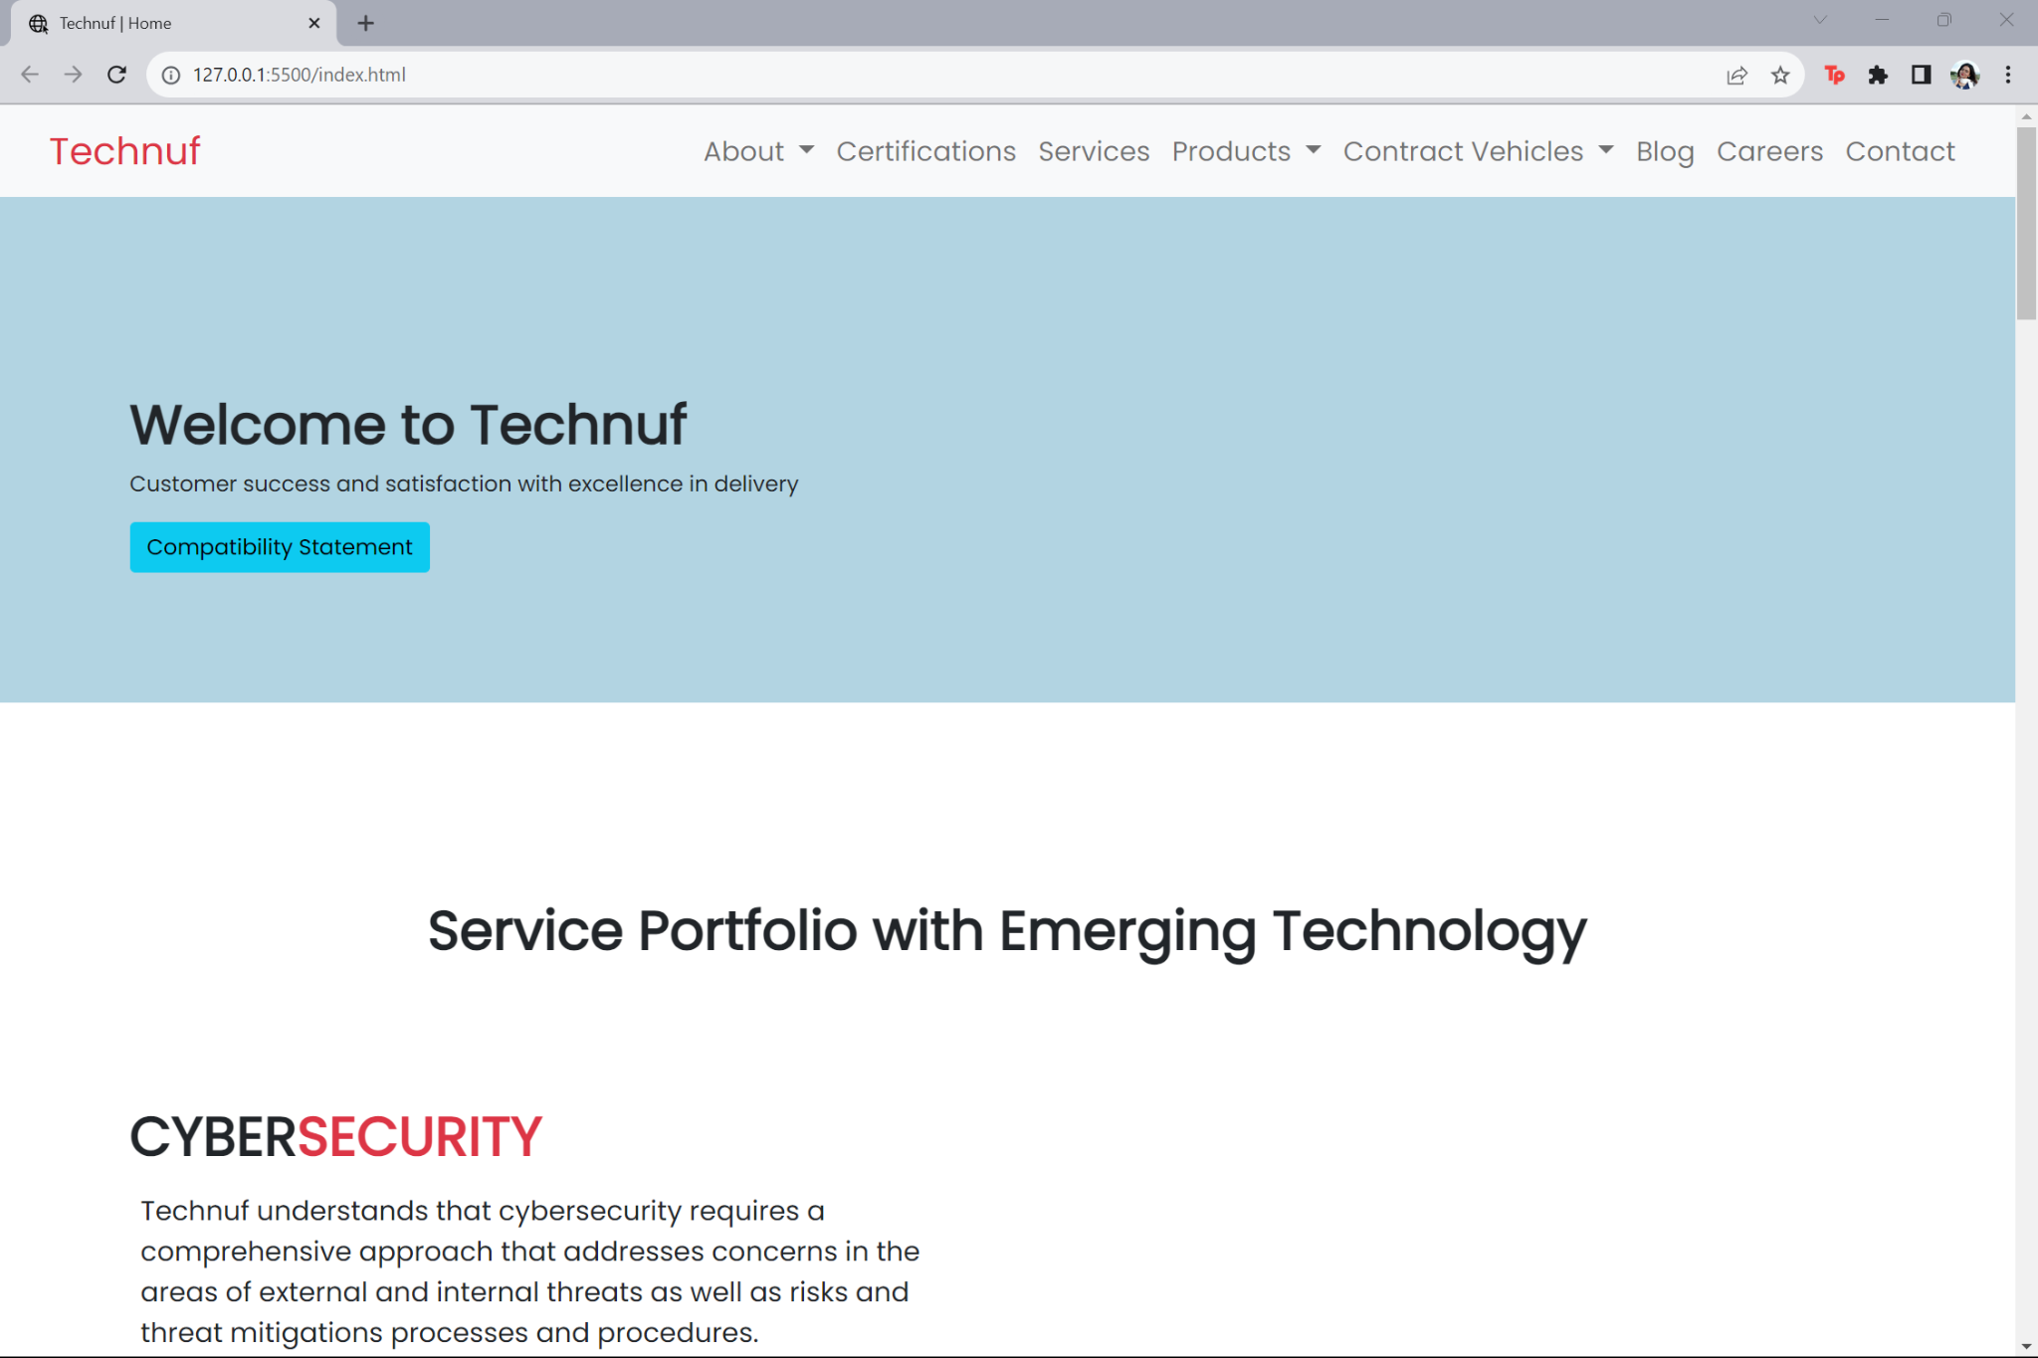
HTML5
Header: A header section that contains
Website’s logo
Navigation Menu
Essential Introductory information

Slide 4

RESPONSIVE CSS STYLING
CSS FRAMEWORK
Using CSS framework like Bootstrap to streamline the styling process. These frameworks offer pre-built, responsive design components.

Slide 5
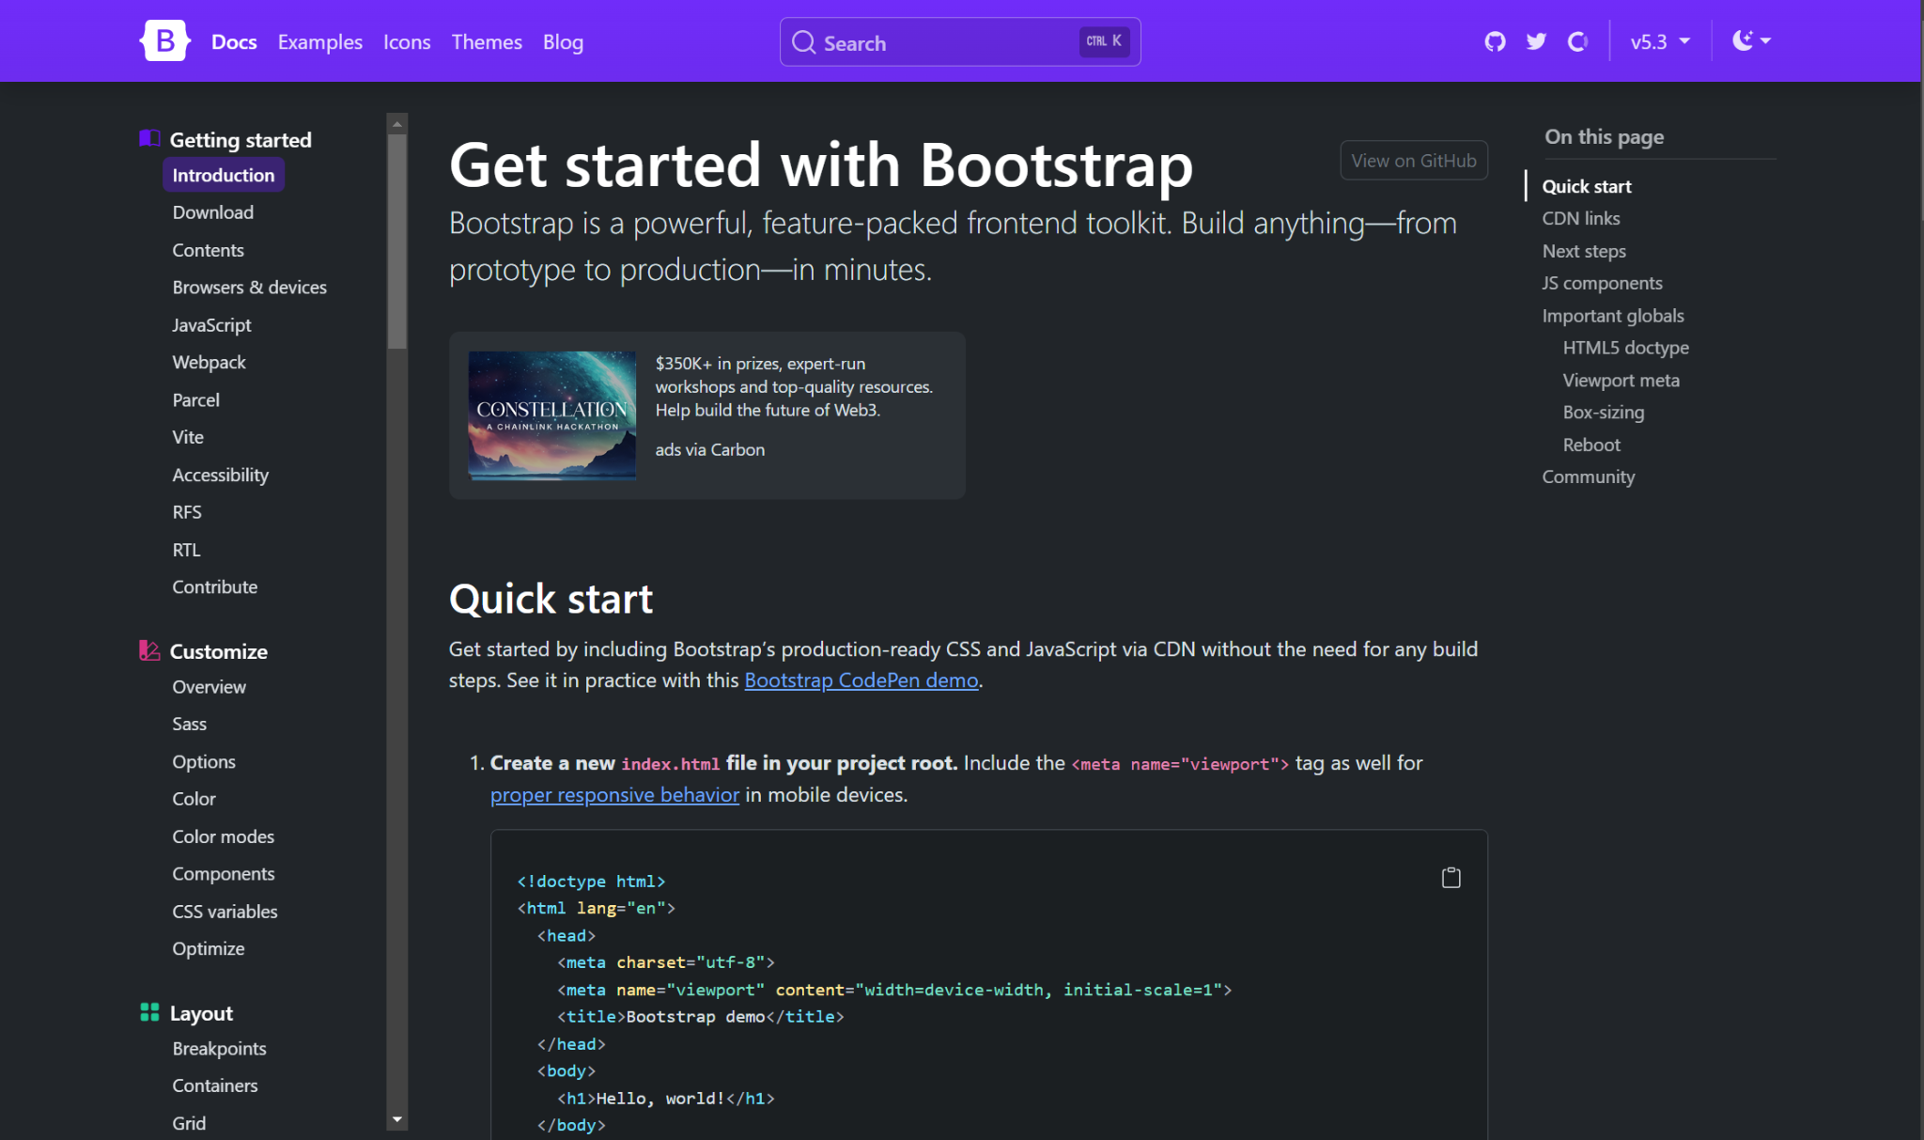
RESPONSIVE CSS STYLING

Slide 6
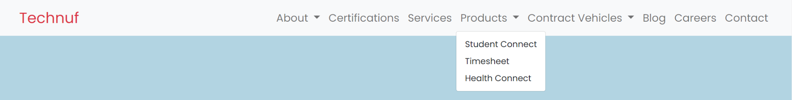
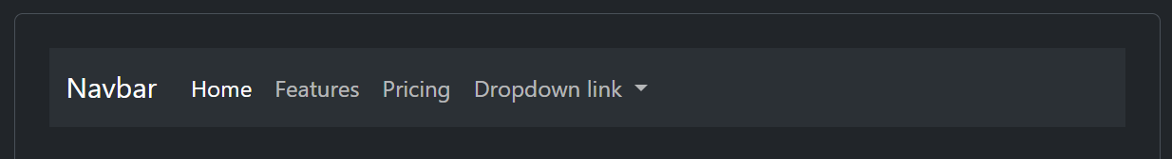
NAVIGATION BAR
Learned the contents of Navbar and dropdown link from Bootstrap and applied those on the front end firsthand. N.B: Will be showing more of what I learnt in the upcoming slides

Slide 7
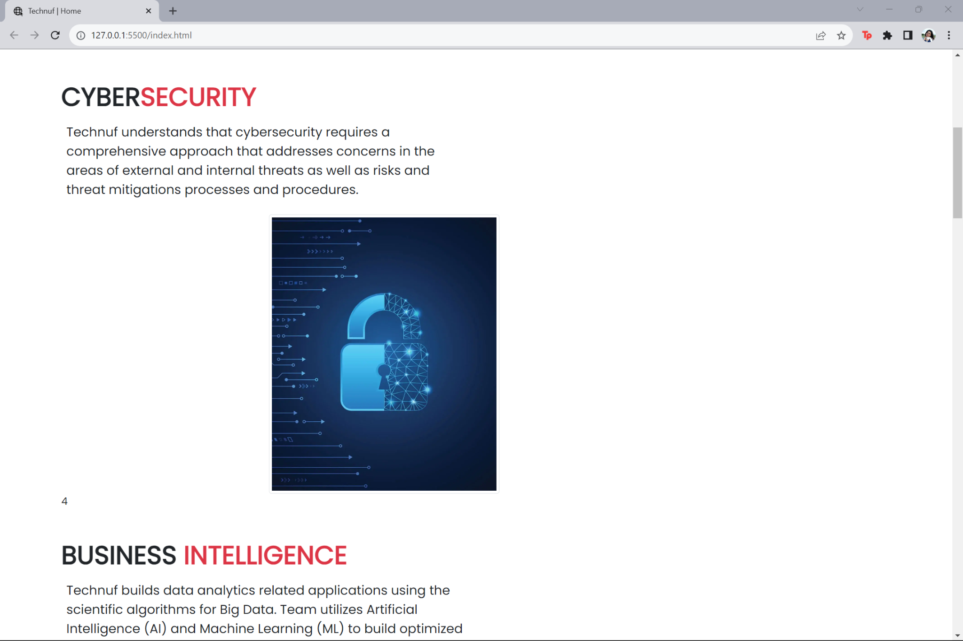
HTML5
Main Content: Core content of the homepage-
Featured sections
Articles
Products

Slide 8
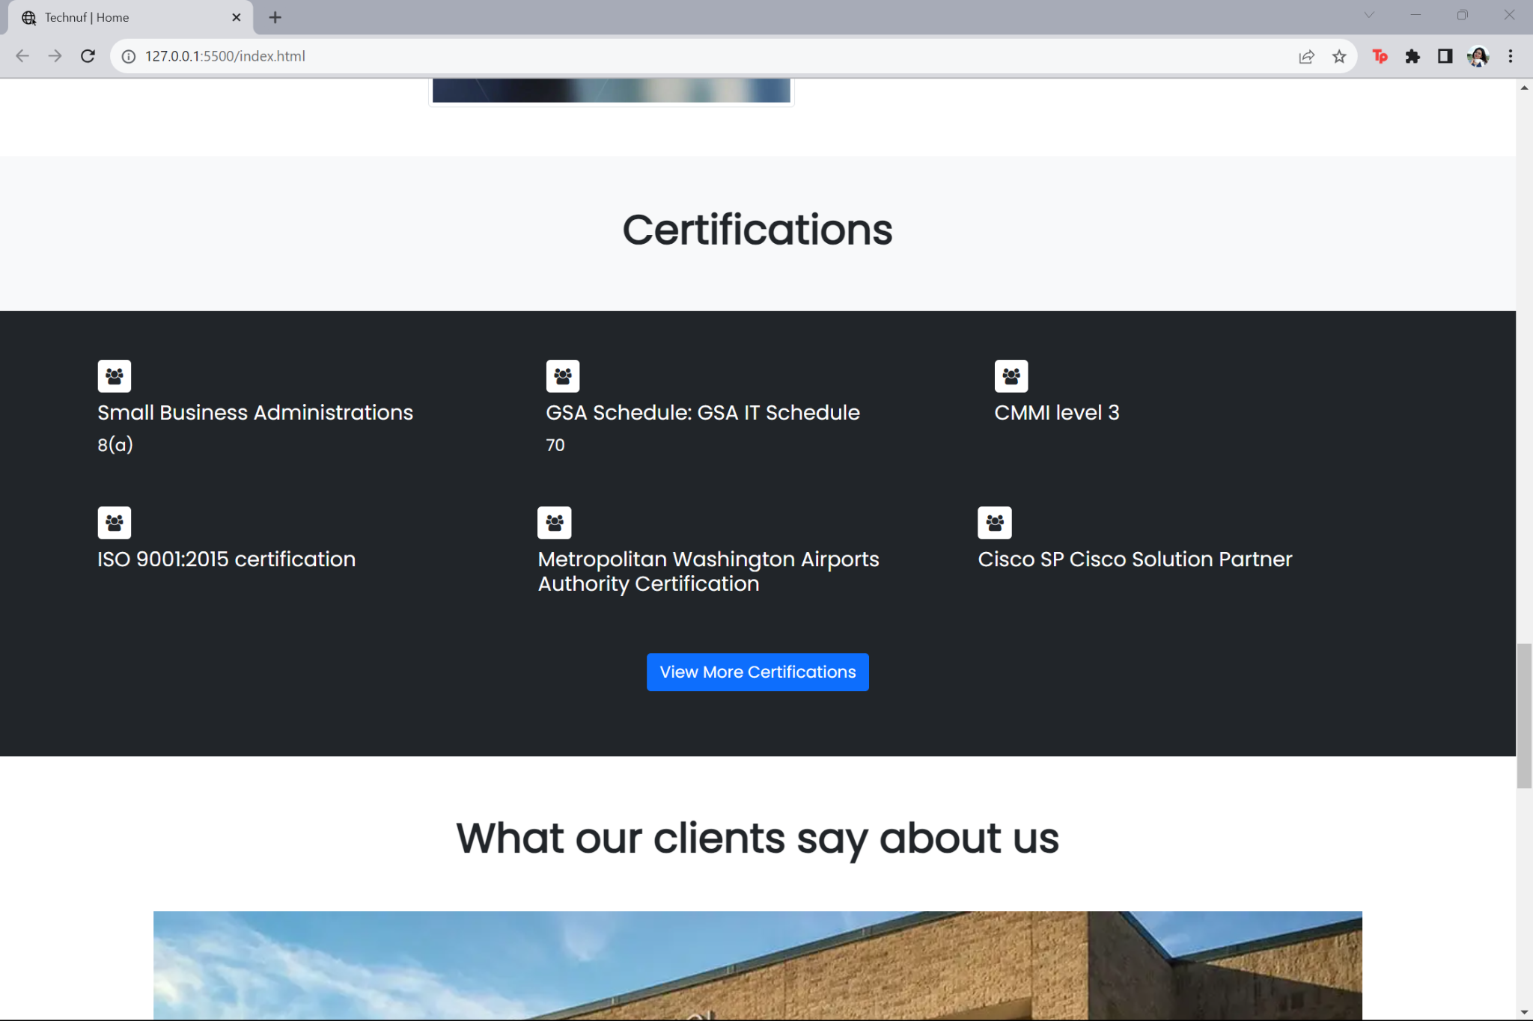
HOMEPAGE

Slide 9
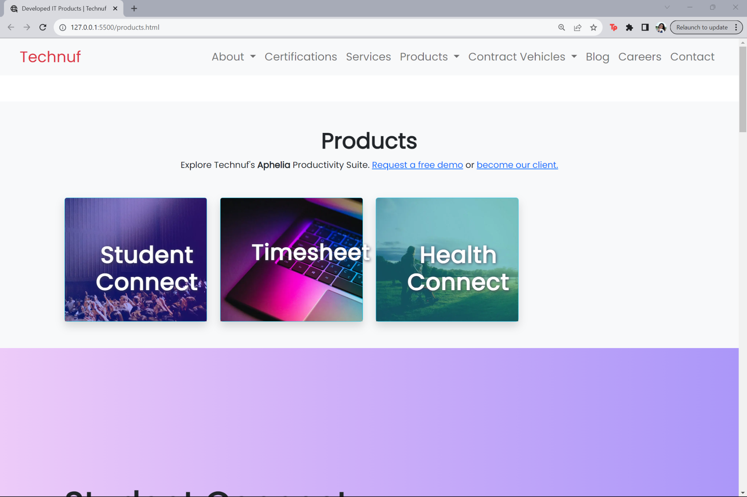
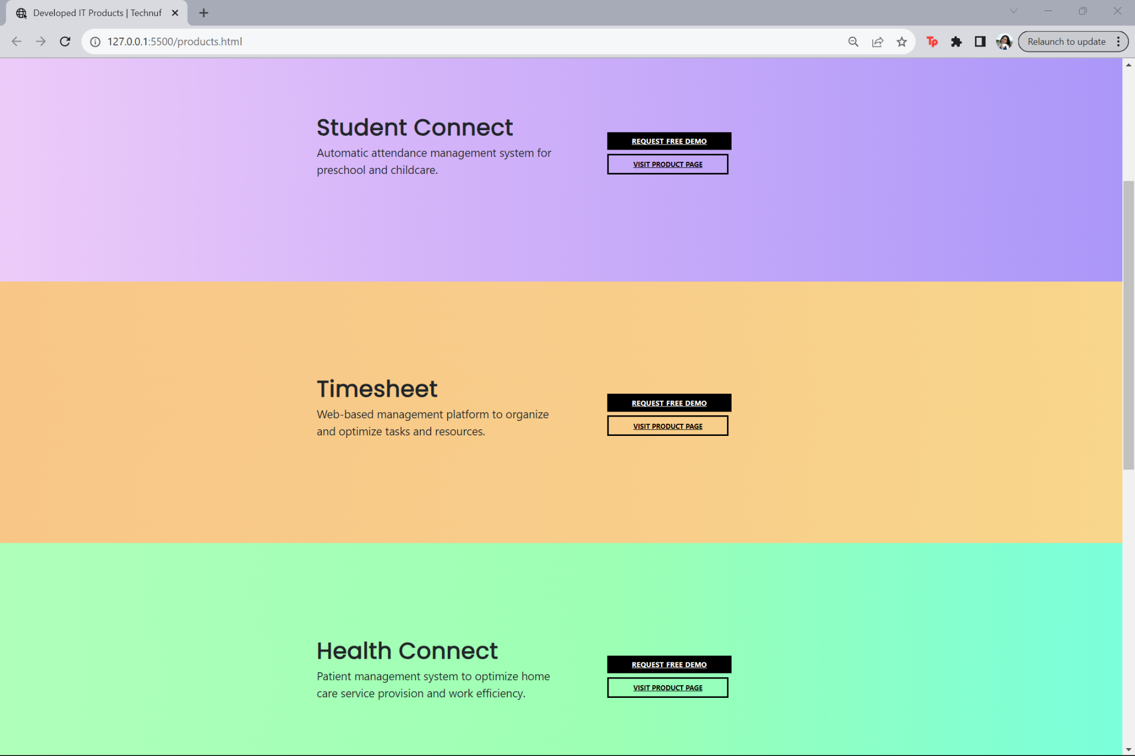
PRODUCTS-PAGE

Slide 10
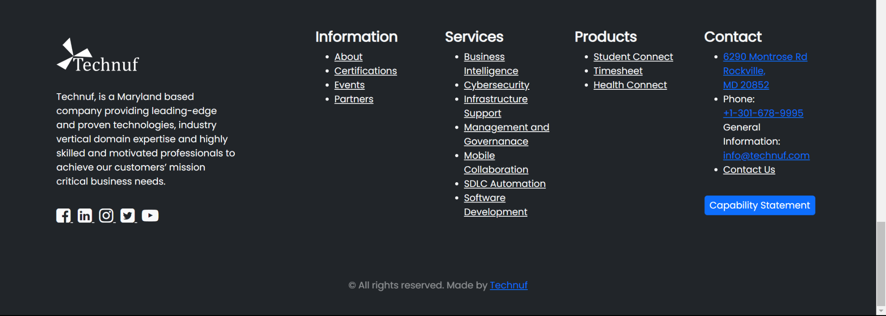
HTML5
Footer:
Contact information
Copyright details
Links to social media profiles

Slide 11
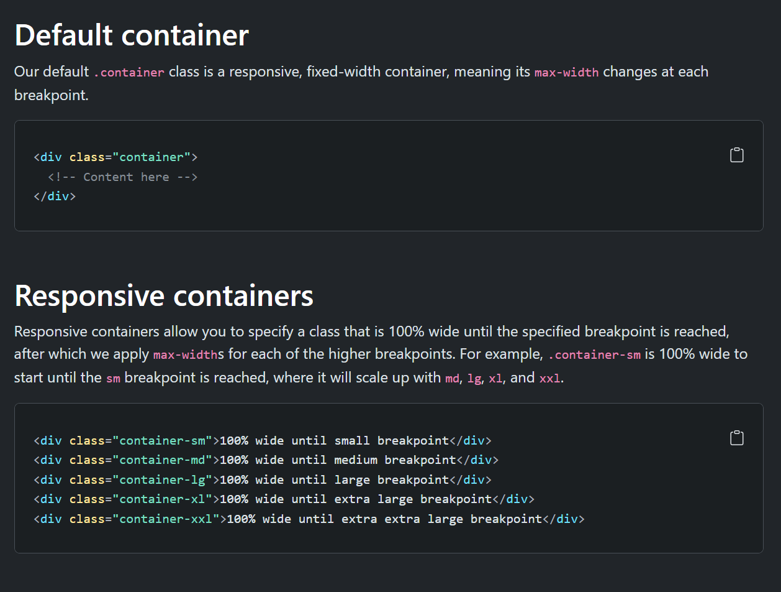
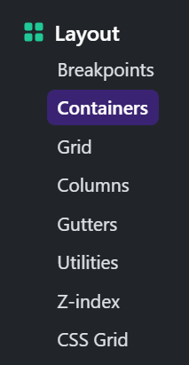
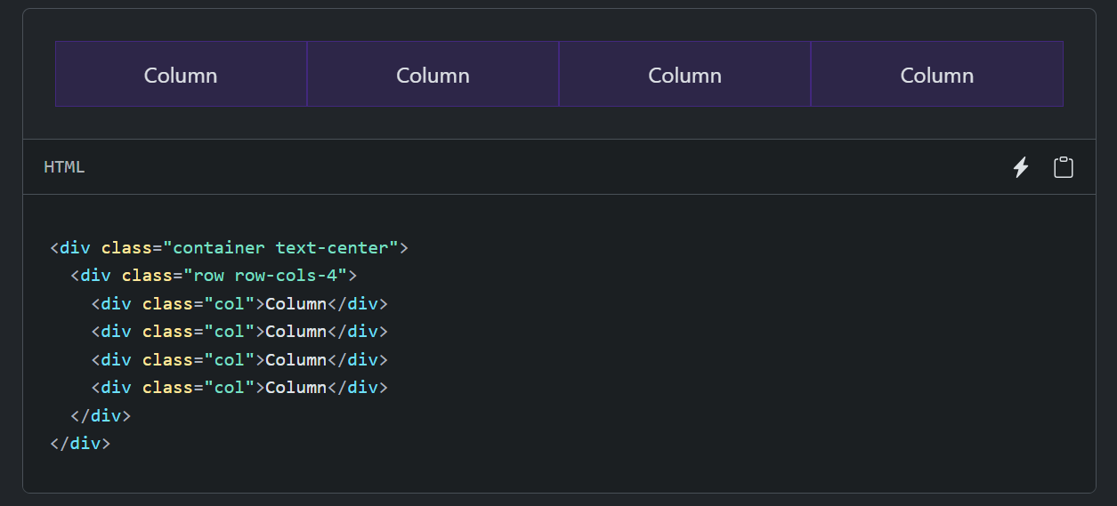
CONTAINERS & COLUMNS
Learned how to use containers and columns in accordance with the section and grid styles.

Slide 12


IMAGES & MEDIA
TYPOGRAPHY & FONT CHOICES
Selecting appropriate fonts and font sizes for readability on all devices or considering linking to custom web fonts through services like Google Fonts
Using responsive image techniques to serve different image resolutions based on the user’s device

Slide 13
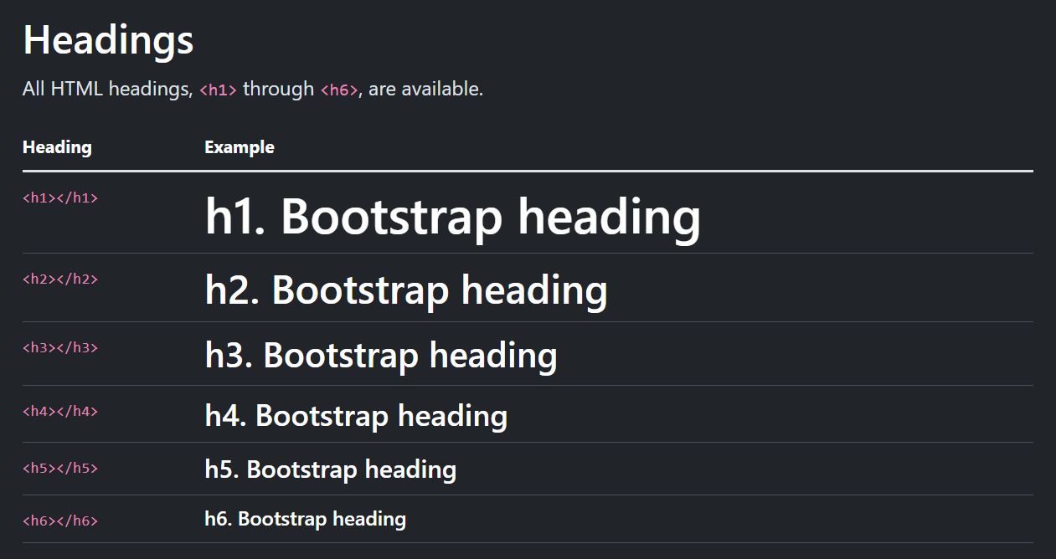
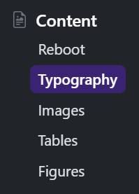
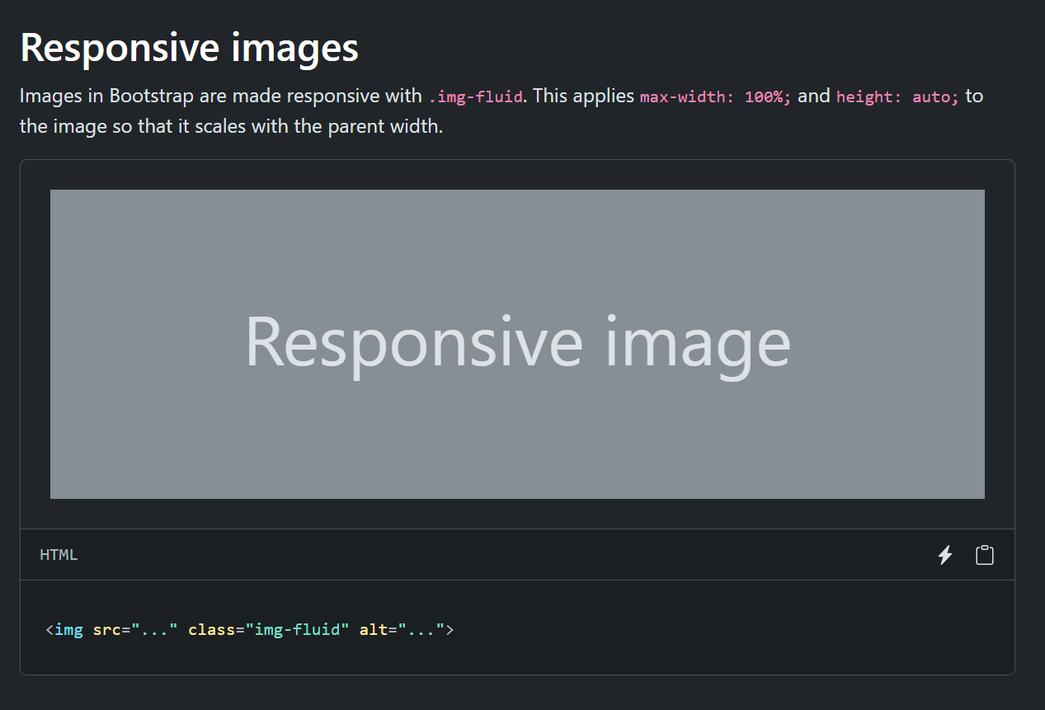
TYPOGRAPHY & IMAGES
Learned to use typography and responsive images to make the website more interactive

Slide 14
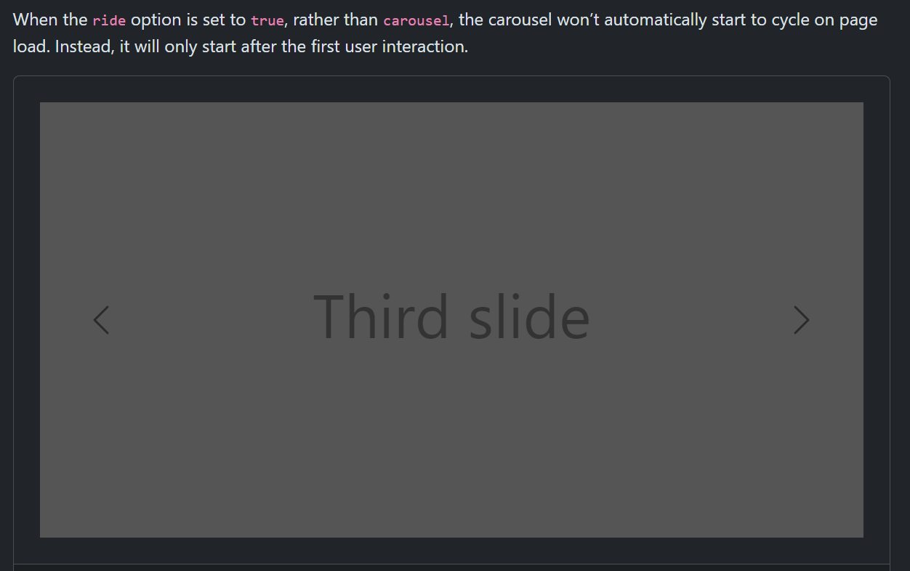
CAROUSEL
Learned to use carousel in the background even though it was not incorporated in the background of the homepage later due to styling issues

Slide 15
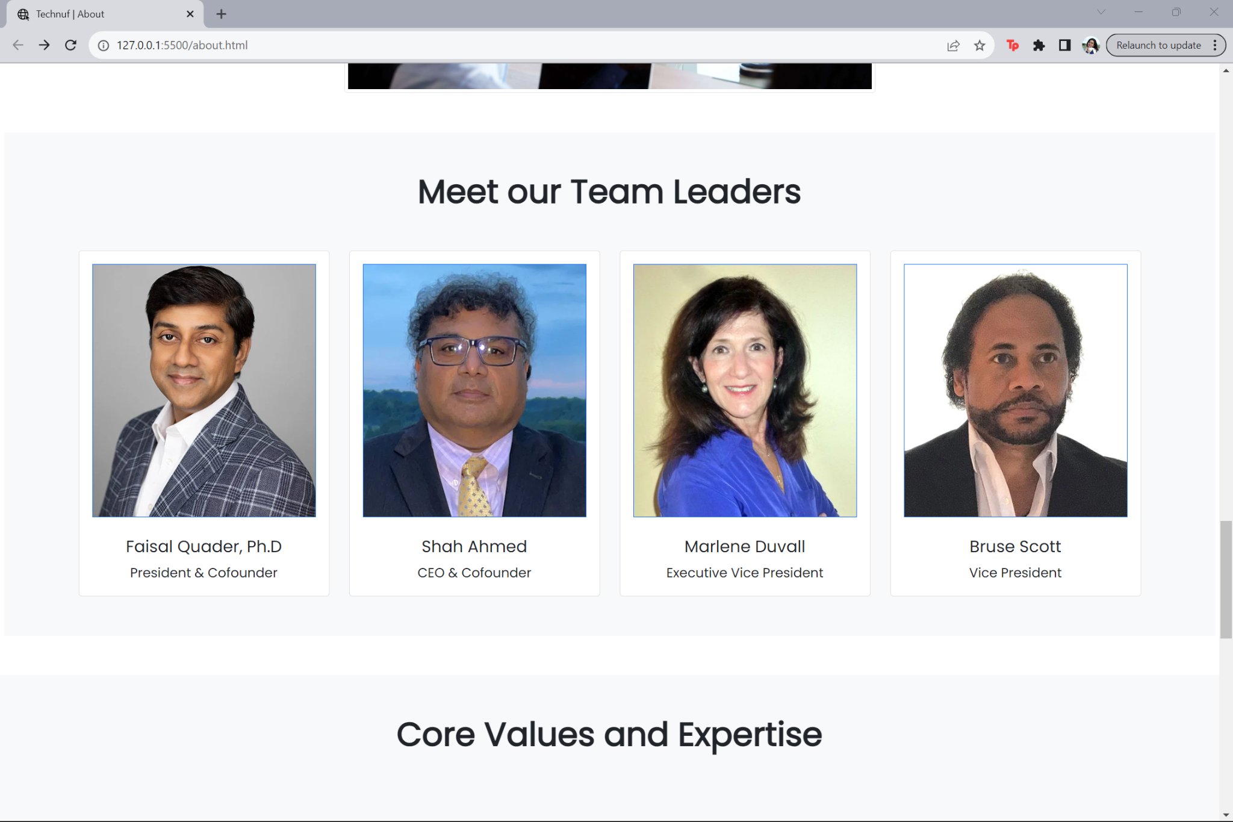
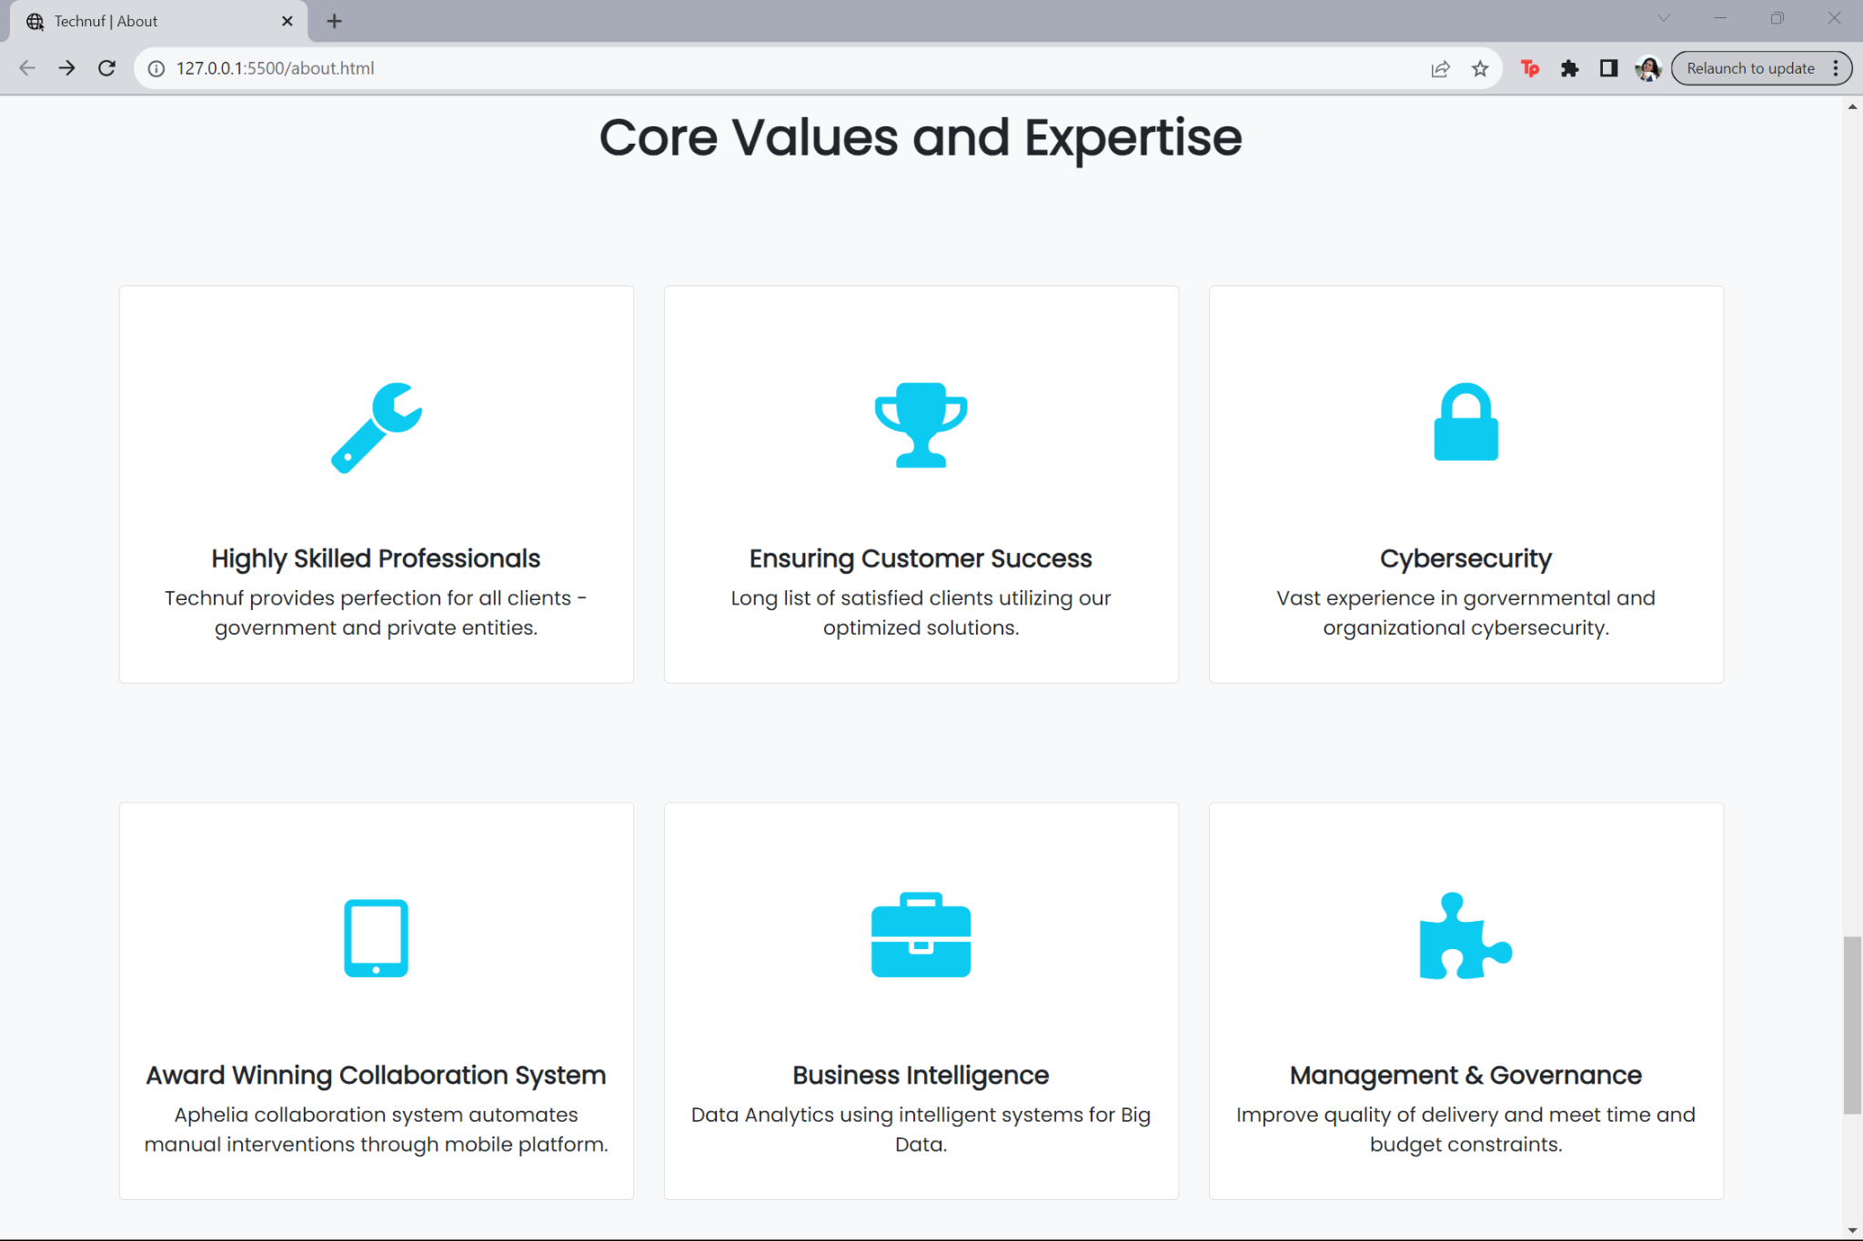
ABOUT-PAGE

Slide 16
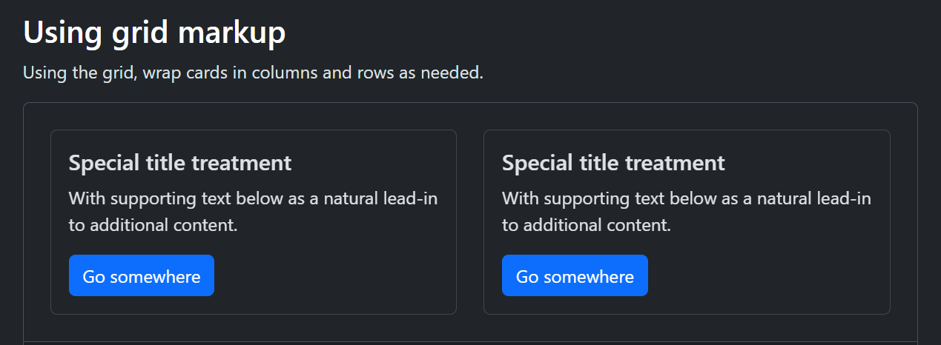
COMPONENTS-CARD
Applied card from the Components section of Bootstrap to make the team leaders-info section and the core values section for the ‘About’ page and the ‘Service’ page as well

Slide 17
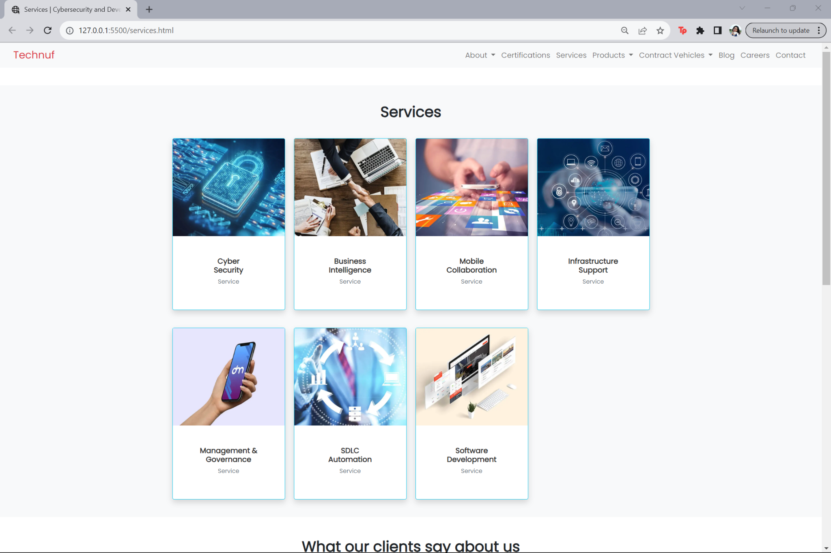
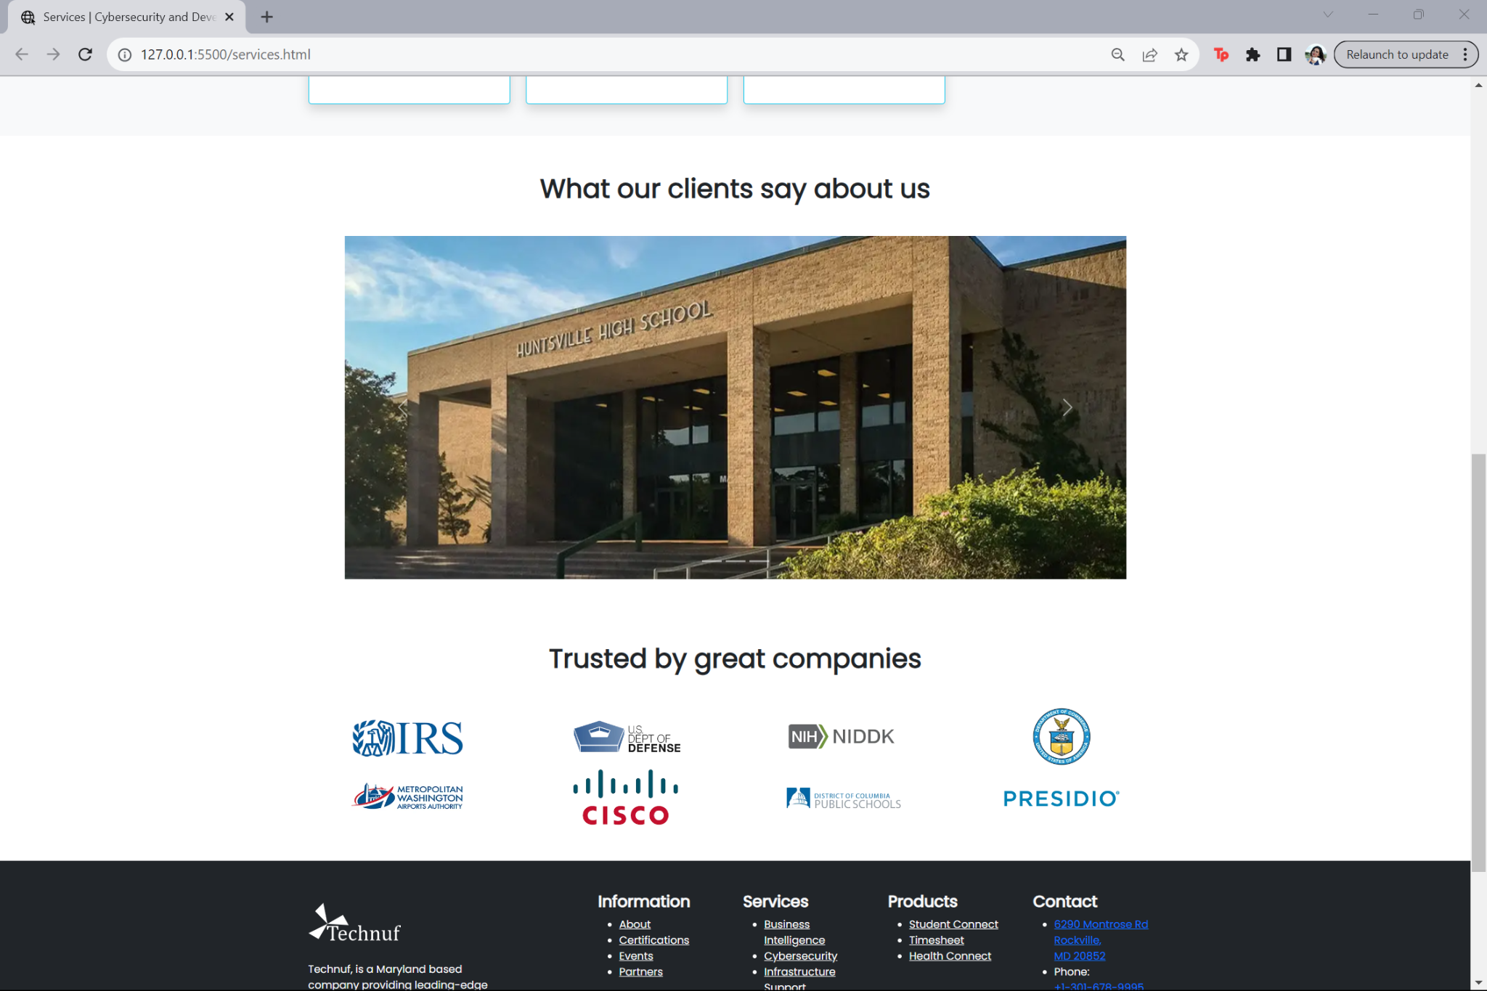
SERVICE-PAGE

Slide 18
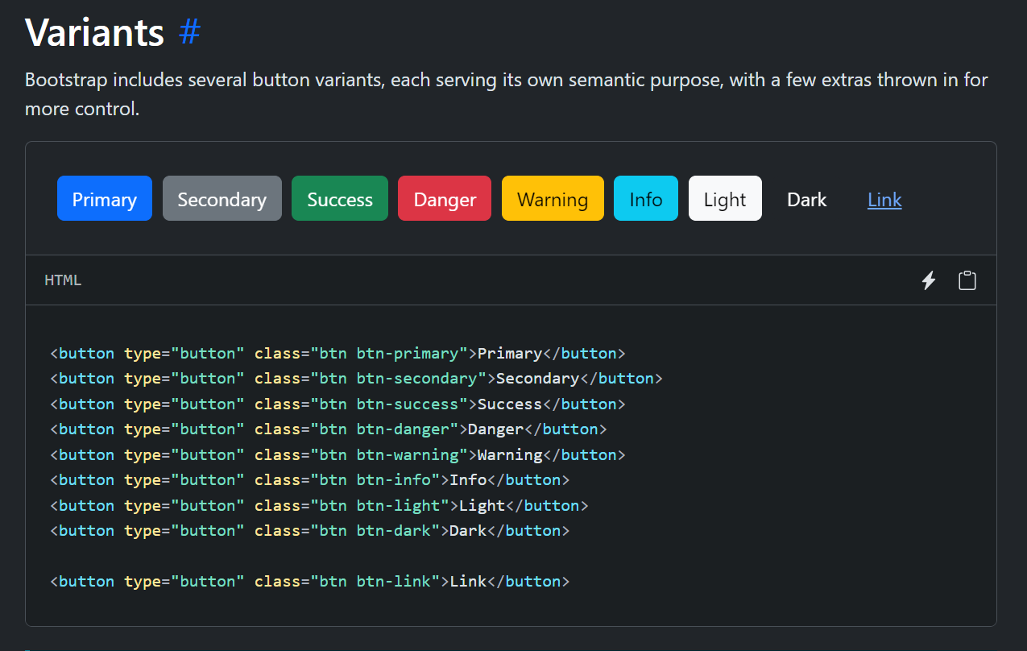
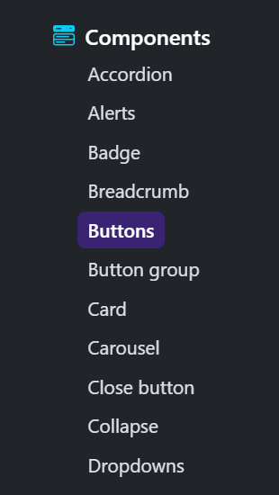
COMPONENTS-BUTTONS
Applied colourful buttons where necessary

Slide 19
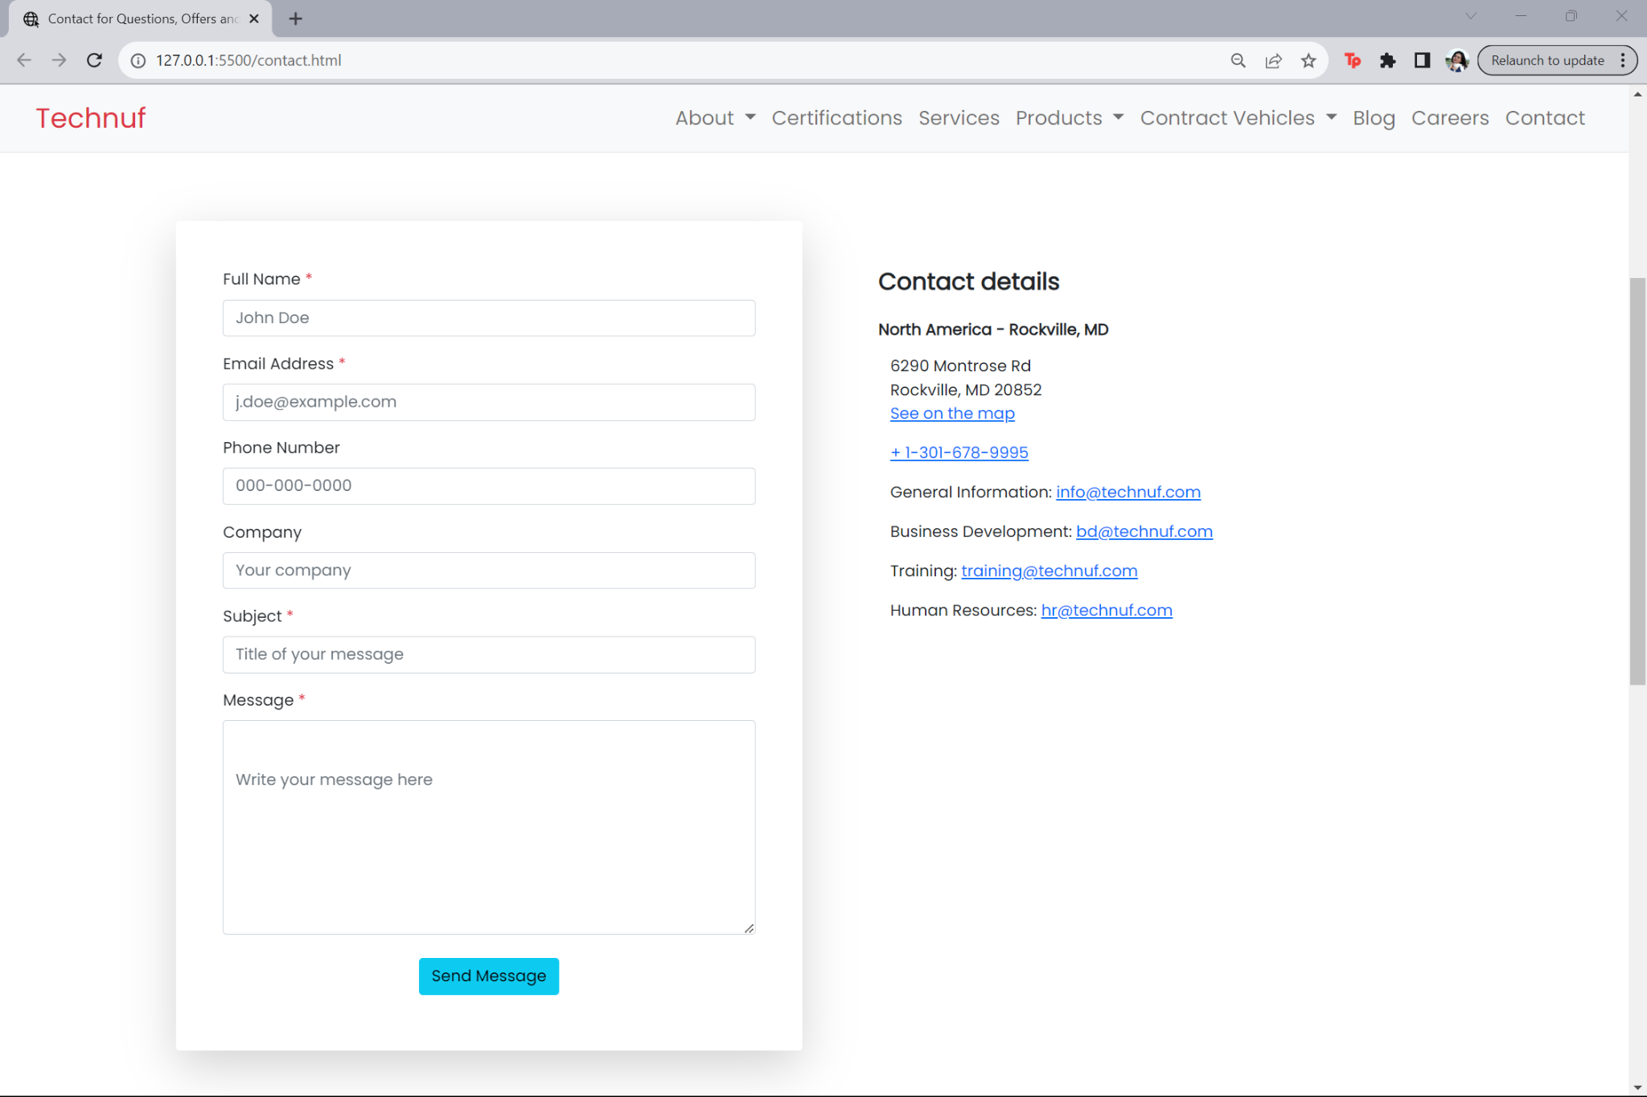
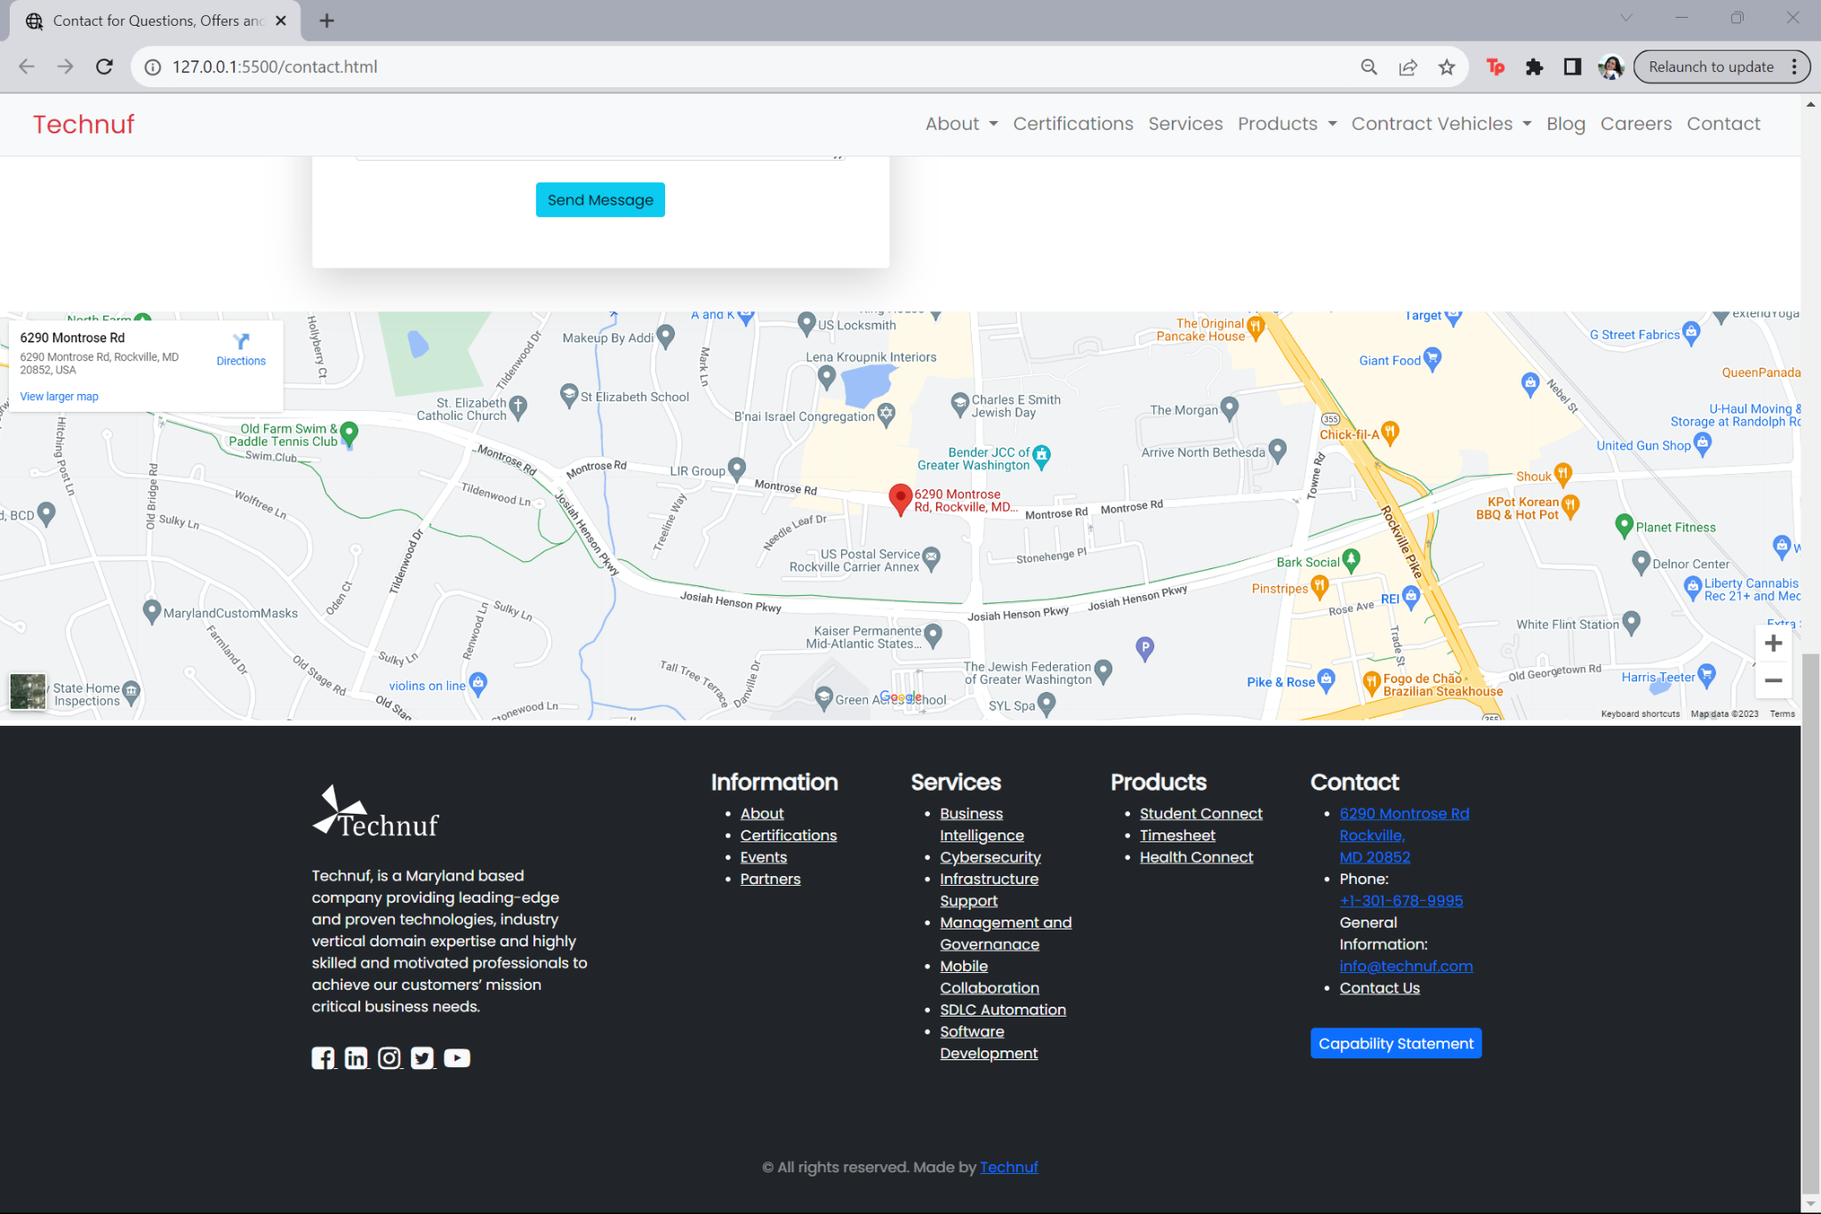
CONTACT-PAGE

Slide 20
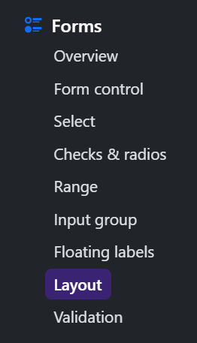
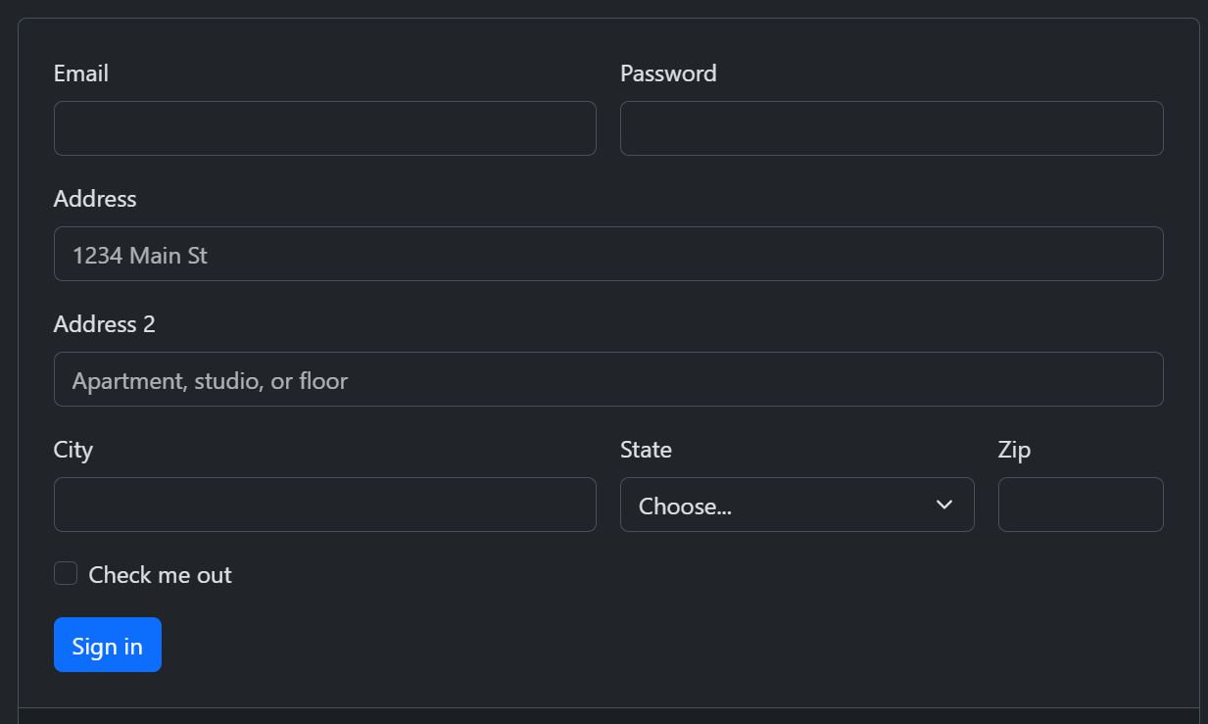
FORMS-LAYOUT
Applied layouts from the Form section of Bootstrap to make the contact section for the contact page.

Slide 21
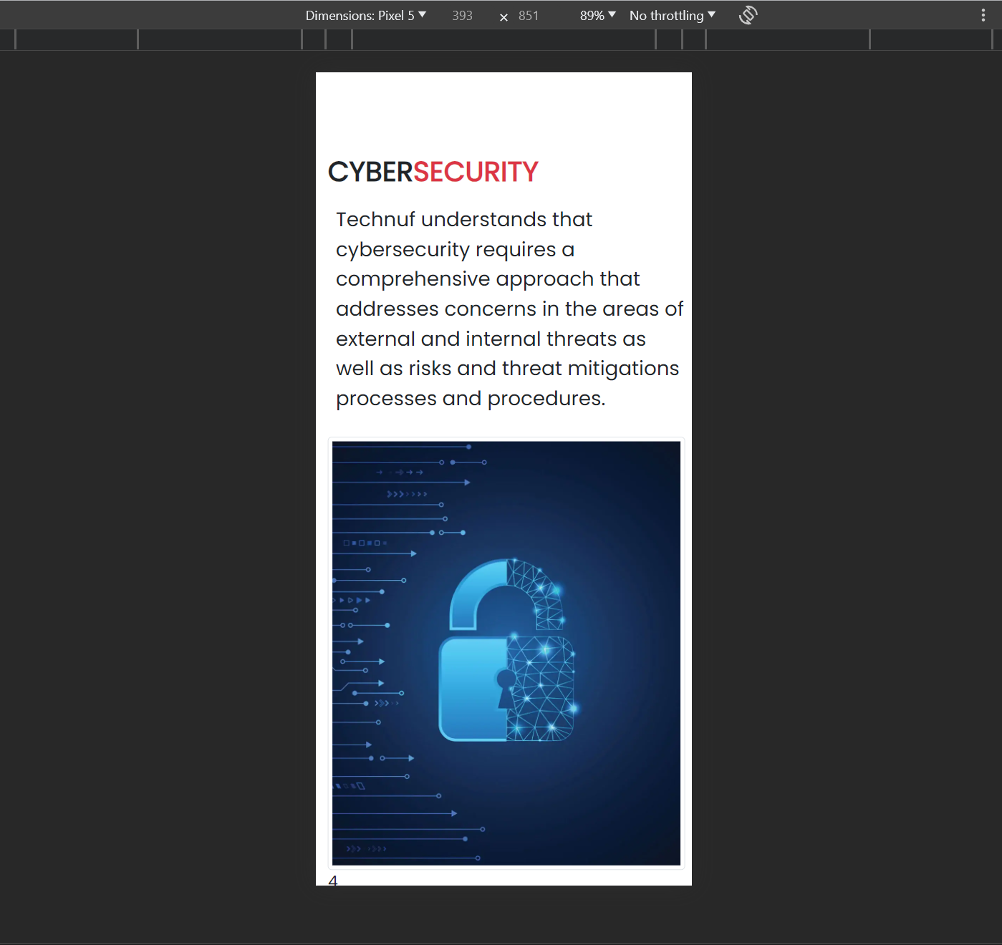
MOBILE-FIRST APPROACH
Designing for mobile devices first, and then progressively enhancing the design for larger screens. This approach ensures that the site looks great on smaller screens and scales up effectively.

Slide 22




Testing and Debugging
Accessibility
Validation
Performance Optimization
Regularly testing the responsive design across various devices and browsers to identify and fix any layout issues
Providing alternative text for images, using proper heading hierarchy, and ensuring keyboard navigation works correctly
Validating HTML and CSS to ensure they meet W3C standards.
Optimizing CSS and JavaScript files, compressing images, and minimizing HTTP requests to improve page load times

Slide 23




CROSS-BROWSER COMPATIBILITY
Testing the website on multiple browsers such as, Chrome, Firefox, Safari, Edge to ensure consistent performance and appearance

Slide 24
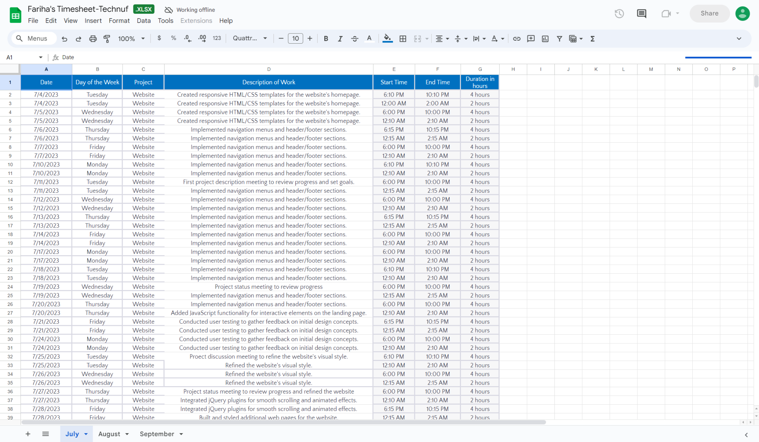
WORK-HOURS

Slide 25
THANK YOU
]

